Slide 1

DAILY COLLEGE CLASS WORK BOOK
Submitted To : -
Bhoopati Subramani Sir
(Assistant Professor)
28940
Submitted By: -
Ekhlakh Ahmad. Reg No.: - 12209166.
Sukhdeep Kaur. Reg NO.: - 12209123.

Slide 2
Introduction
The Daily College Class Work Report Book is a web-based application developed using PHP.
this document is to specify the requirements for the development of a web-based system that manages daily class work and activities in a college setting using PHP.
This system aims to streamline the process of recording and accessing classwork, making it easier for both students and teachers and instructors to stay organized and informed

Slide 3
Scope
This project aims to create a comprehensive system that allows colleges to record and manage.
daily class activities,.
Assignments.
Subject list.
Lesson Plan.
Schedule.
And generate reports for academic purposes.

Slide 4
features
User Registration: - Student should be able to register for an account by providing their essential information.
Such as Name, E-mail and Password.

Slide 5
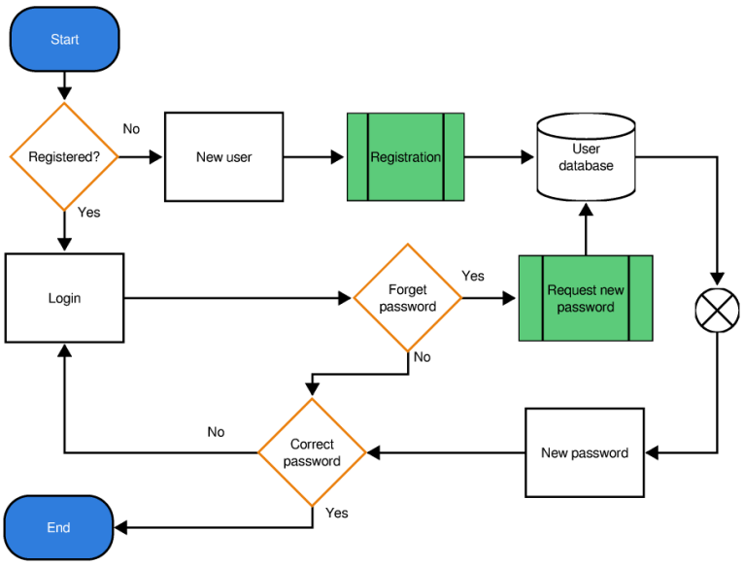
Login page diagram

Slide 6
Class notes
Upload and Storage.
Categorization.
Accessibility.
Assignment Task.

Slide 7
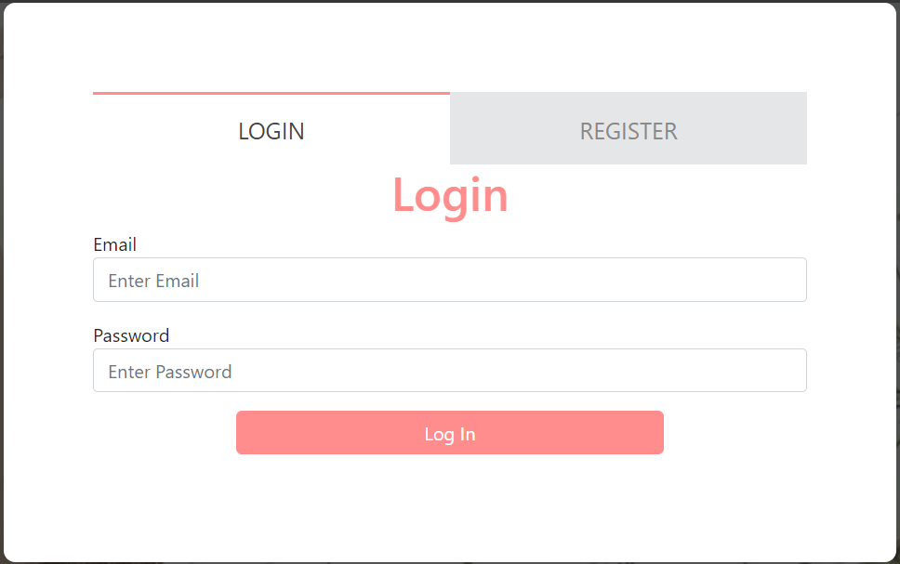
login Page

Slide 8
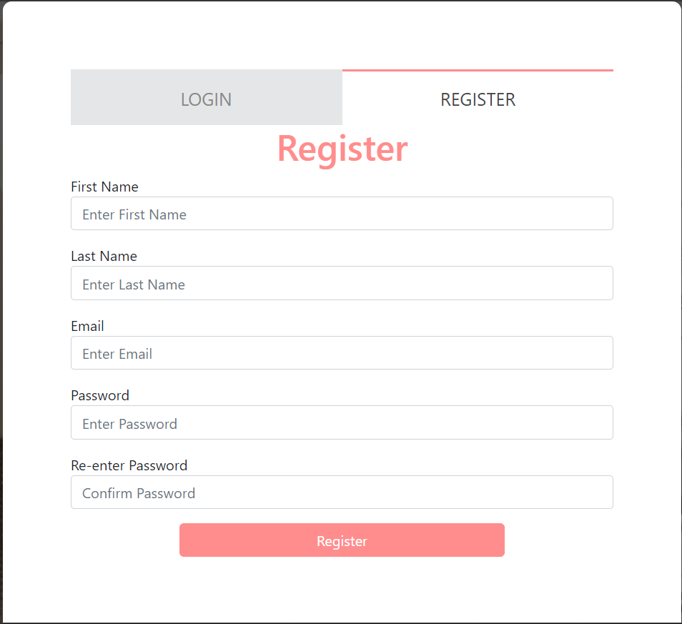
register page

Slide 9
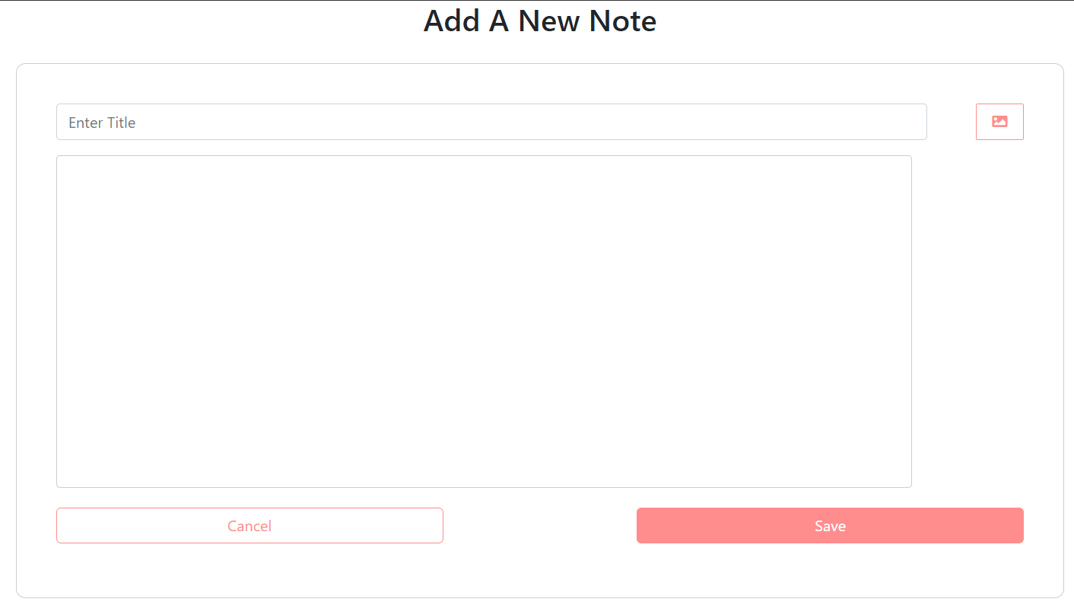

Slide 10
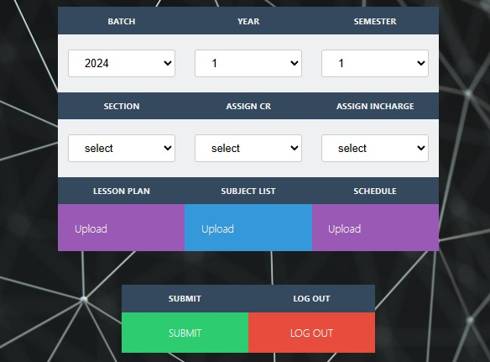
Setup page

Slide 11
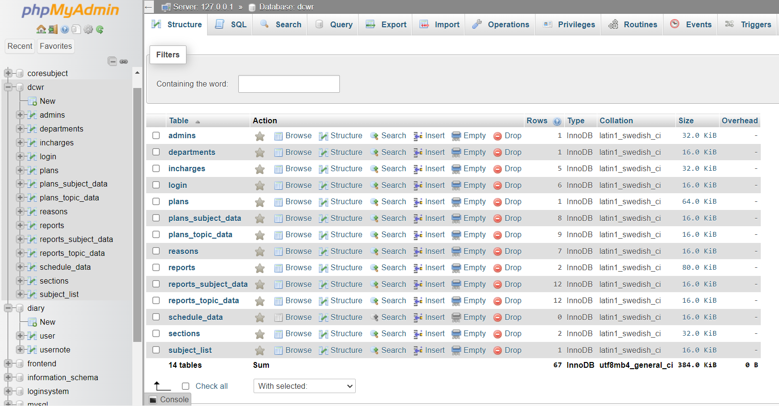
database

Slide 12
THANK YOU

